Slide 1
COPADS
#11 – P2P
IFEOLUWATAYO IGE

Slide 2
OUTLINE
Peer-to-Peer Computing
P2P Taxonomy- categories
Cons of P2P
Distributed Hash Table (DHT)
Chord DHT
Simple Lookup
Scalable Lookup

Slide 3
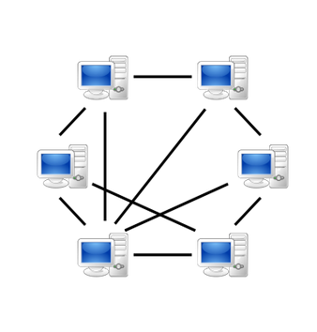
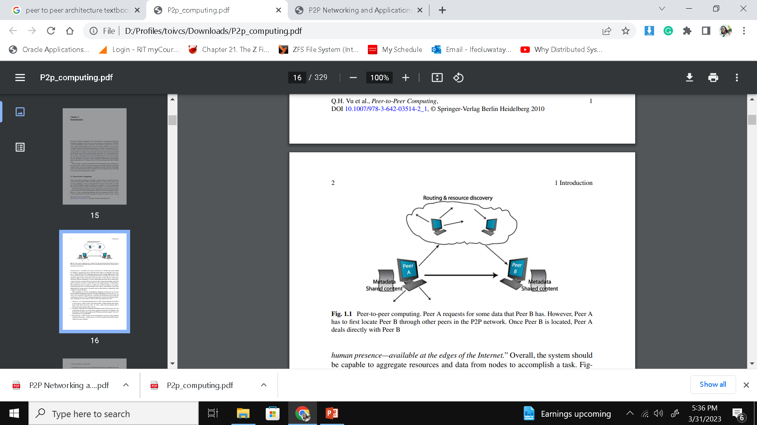
Peer-to-Peer Computing
In peer-to-peer, all peers are independent. Although resources could be shared across the network
Peer A may request some data from Peer B. However, Peer A may have to locate Peer B through other peers in the P2P network.
Once Peer B is located, Peer A deals directly with Peer B
Drawbacks:
Availability of Peers is unpredictable per time.
In a P2P environment, data may be replicated and cached in many Peers. It is hard to maintain the integrity and consistency of all the copies AT THE SAME TIME. There is always a need to remove outdated copies or refresh them.

Slide 4
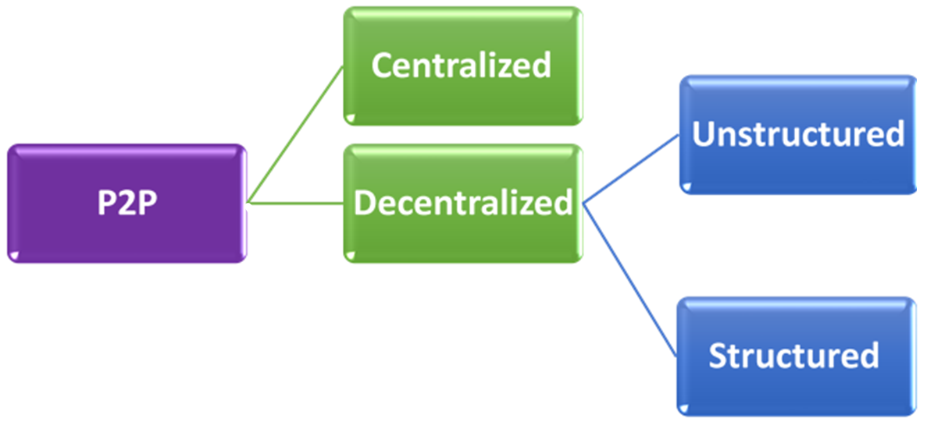
P2P Systems Taxonomy

Slide 5
Centralized Peer-to-Peer
Centralized P2P systems beautifully mix the features of both centralized (e.g., client-server) and decentralized architectures
One or more central servers help peers locate their desired resources or act as task schedulers
This speeds up the process of resource location
Has information about all the possible Peers that maintain the desired files
To locate resources, a peer sends messages to the central server to determine the addresses of peers that contain the desired resources
Like a decentralized system, once a peer gets the information requested from the server, it can communicate directly with other peers (without going through the server anymore)
Share similar cons as with client-server architecture such as single point of failure among others

Slide 6
Decentralized Peer-to-Peer
Peers have equal rights and responsibilities.
Each peer has only a partial view of the P2P network and offers data/services that may be relevant to some peers
The network is immune to a single point of failure
Could be unstructured or structured

Slide 7
Decentralized-Unstructured
In an unstructured P2P system, each peer is responsible for its data and keeps track of a set of neighbors to whom it may forward queries. This means:
Locating data in such a system is challenging since it is difficult to precisely predict which peers maintain the queried data; there is no guarantee of the completeness of requests (unless the entire network is searched),
There is no guarantee of response time
Neighbors are determined based on a peer’s interests.
There is always an inherent assumption that a peer is likely to be issuing similar queries during a period of time.
Peers who have previously provided answers are assumed to still be alive on the network to continue to provide answers as well.
Thus, keeping these Peers as neighbors can reduce the querying time (in the immediate future).
However, as the user interests (reflected by the queries) change, the set of neighbors may change. Hence reconfiguration of neighbors may always be done as user interest changes.

Slide 8
Decentralized-Structured
In a structured P2P system, there is a mapping between data and peers.
Distributed hash table (DHT) is used to facilitate the sharing of resources, such as files or data, between peers.
These systems provide a guarantee (precise or probabilistic) on search cost. This, however, is typically at the expense of maintaining certain additional information.
Drawback: Since data location is tightly controlled, the computational cost of maintaining the routing information is high, especially in a dynamic network environment, where peers may join and leave the network at will.

Slide 9
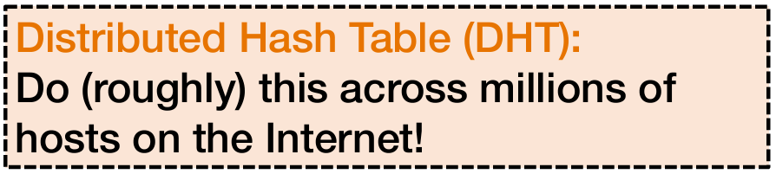
Distributed Hash Table (DHT)
Local hash table:
key = Hash(Data)
put(key, Data)
get(key) Data
DHT is used for partitioning data in a large-scale distributed system. Data partitions could be:
Tuples in a global database engine
Data blocks in a global file system
Files in a P2P file-sharing system

Slide 10
Chord DHT
Chord is an algorithm for a peer-to-peer distributed hash table that uses consistent hashing
Consistent hashing is used to balance the load on the network so that each peer receives roughly the same number of keys and requires relatively little movement of keys when peers join and leave the system.
The SHA-1 algorithm is the base hashing function for consistent hashing.
Each peer has an ID.
If m bits Hash algorithm is used, we can only have a maximum of 2^{m} key-value pairs and IDs (peers) in a distributed network
For each Peer; Hash (IP address and Port number) = ID which will be a value between 0 and 2^{m}-1

Slide 11
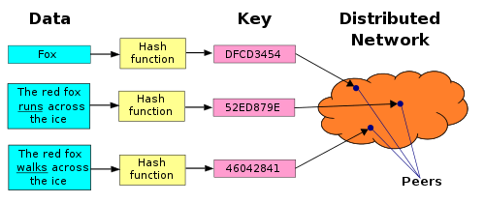
Assigning Key-Value pairs to Peers
Assign key-value pair to the peer that has the closest ID.
Eg., Suppose we have ID space with range {0,1,2,3,…,63}; every key /value pair has keys between 0 and 63 and every peer ID has a value between 0 and 63.
Suppose we have a DHT with 8 peers: 1, 12, 13, 25, 32, 40, 48, 60
if a key = 51, we store the key-value pair in the closest successor to 51 which is peer 60
If key =60, store key-value pair in peer 60 since peer 60 exists
If key =61, store the key-value pair in peer 1 since a peer with that value does not exist among the peers.

Slide 12
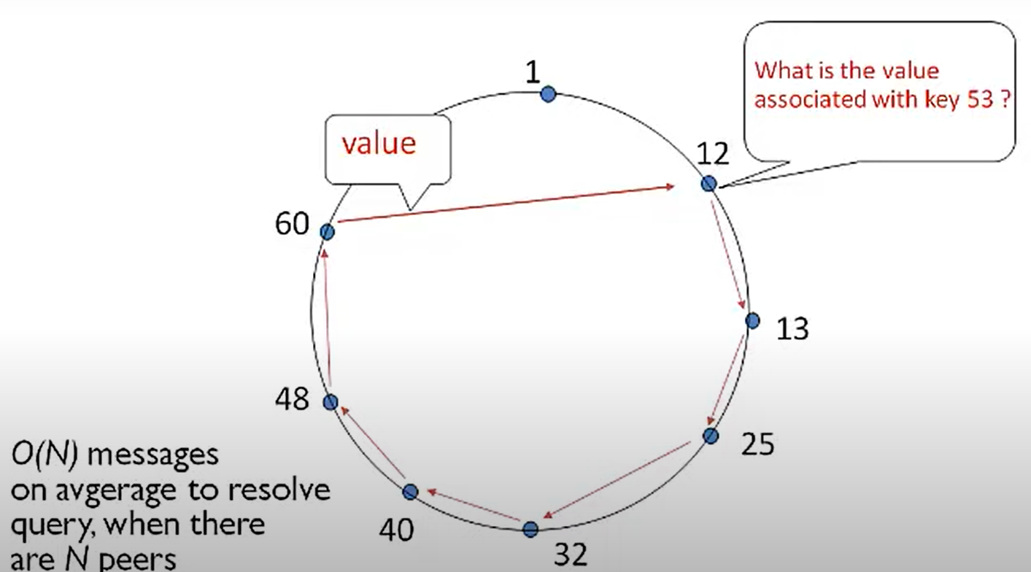
CHORD: Simple Lookup
Each Peer has information about its immediate successor peer.
When one peer is added or removed, only its successor peer is updated
Easy to manage but not efficient as the search takes quite a time if the peers are many
Search time is O(n)

Slide 13
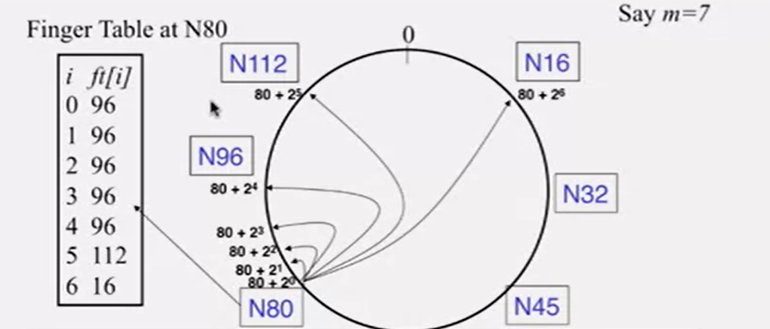
CHORD: Scalable Lookup
Each Peer identifier n maintains a finger table consisting of m successor Peers.
m is the number of bits of the hash algorithm
Entry i in the finger table of Peer n is the first Peer that succeeds or equals n+ 2^{i}
where 0 ≤ i ≤ m − 1 (all arithmetic is modulo 2^{m}) and n is the peer’s ID.
To populate the table,
Find a Peer that succeeds or equals (n+2^{i})
If no Peer succeeds or equals (n+2^{i}) in the ring,
find the Peer that succeeds or equals (n+2^{i})(mod 2^{m})
For i=6, 80+ 2⁶= 144 which is not in the ring.
144 mod128 =16

Slide 14
Files Storage and Search
Files are converted to a hash value which is saved in the Peer having the same ID or the Peer with the next higher ID. (Remember that for each Peer, Hash(IP and port) gives an ID
Eg. A file converted to hash value 3 should be stored in a node with ID 3 or any other next node of higher ID.
Scalar Look up Search has O(Log(n)) performance which is faster . This is because since each Peer has some more information about other Peers, it can easily hop a few times to get to its destination.
Assume Peer 32 is searching for a file named “foo.mp3” whose hash is 82.
What if you don’t know if Peer 82 exists or its location?

Slide 15
Search
N70’s
Finger Table
N79’s
Finger Table
N80’s
Finger Table
(0)
N113
N32’s
Finger Table
71 N79
72 N79
74 N79
78 N79
86 N102
102 N102
6 N32
80 N80
81 N85
83 N85
87 N102
95 N102
111 N113
15 N32
81 N85
82 N85
84 N85
88 N102
96 N102
112 N113
16 N32
N102
0 33 N40
1 34 N40
2 36 N40
3 40 N40
4 48 N52
5 64 N70
6 96 N102
N32
N85
N40
N80
N79
N52
N70
N60
Peer 32 is searching for key 82:
32 → 70 → 79 → 80 →85.
Note that M =7
1. What is the time complexity for the search time for scalable look-up?
2. What is the maximum number of peers allowed in this network?

Slide 16
New Peer Join
To join a network,
Initialize Peer n by getting the ID and its finger table
The new Peer takes over its responsible keys from its successor.
Update the predecessor’s finger table
(0)
N113
N20’s Finger Table
N20
21 N32
22 N32
24 N32
28 N32
36 N40
52 N52
84 N102
N102
N32
N80
N40
N52
N70
N60

Slide 17
After joining,
Update the predecessor’s finger table
Move relevant keys from successor peer to new peer.
(0)
N113
N20’s Finger Table
N20
N102
21 N32
22 N32
24 N32
28 N32
36 N40
52 N52
84 N102
114..20
N32
N80
N40
N52
N70
N60
Notify Peers that must include
N20 in their table. N113[1]=N20,
not N32.
Peer 20 moves keys from Peer 32.

Slide 18
Stabilization Protocols
Each Peer in the system needs to periodically run a stabilization protocol
This protocol periodically updates finger tables of affected Peers and successor pointers.
The stabilization protocol works as follows:
Notify(): notifies n's successor of its existence, so it can change its predecessor to n
Stabilize(): n asks its successor for its predecessor p and decides whether p should be n's successor instead (this is the case if p recently joined the system).
Fix_fingers(): updates finger tables

Slide 19
Implications of using Chord DHT in a P2P Distributed System
New peers may join. There will always be a constant need to generate finger tables for new peers; update the predecessor’s finger table and copy keys from successor peers
P2P systems have a high rate of churn (node join, leave, and failure due to sudden disconnection from the network), and so data may be lost!
In a fully decentralized p2p environment where you have no control over individual nodes you cannot really guarantee that data stays in the network forever by itself.
To achieve redundancy, the target nodes may replicate data among themselves or the originating node may periodically refresh the stored data.
Note that DHT is a distributed algorithm that is usually just used to speed up data search, and discovery ☺

